Slide 1

NBA Shot Log Analysis
DSC 650 by Jesse Zamora

Slide 2
NBA Shot Log Analysis
Introduction

Slide 3
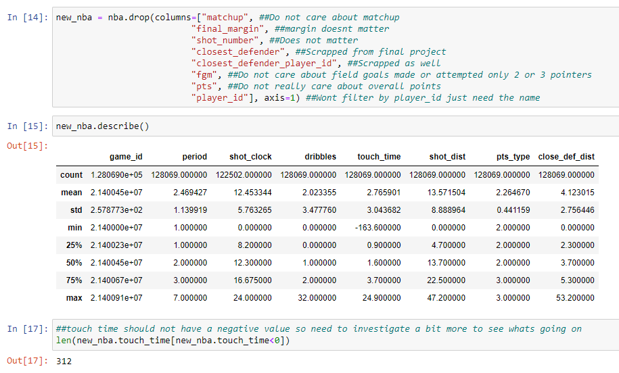
EDA
Weird issue with touch time having a negative value
Remove the negative value and replace with mean
Shows how some data can have errors
Shows how to fix errors in data
Replacing value with the mean is a way to show that you are not influencing the data

Slide 4
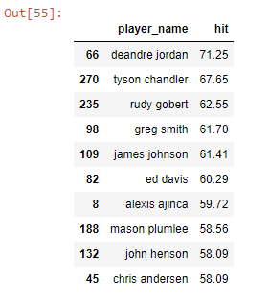
Key Findings
Shot percentage by player
Players that make the most “hits”
Deandre Jordan ranks the highest at 71.25 percent
Expected results were that the players highest scorers would be on the list, however, a lot of defensive players were located here.

Slide 5
Interesting finds

Slide 6
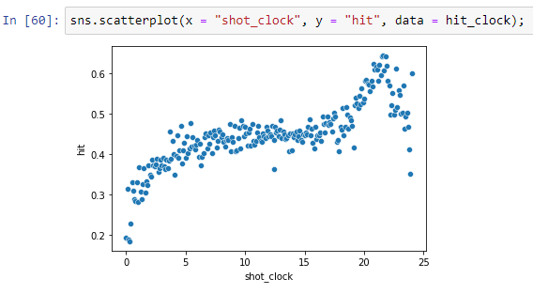
Scatterplots and hit rates
Hit rate by seconds left on the shot clock
20-22 seconds!
This chart shows that 20-22 seconds on the shot clock is the highest percentage of made shots
Dropping down immediately

Slide 7
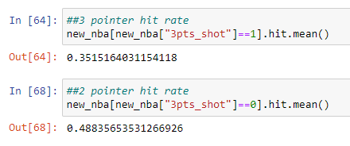
3 pointer vs 2 pointer
Which shot is better?
2 pointer has the higher hit rate
35 percent for 3 pointer
48 percent for 2 pointer

Slide 8
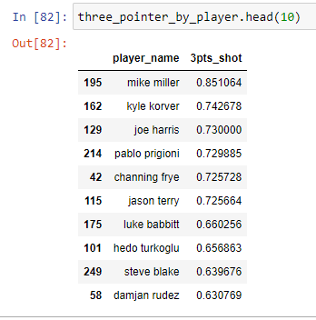
3 pointers by player
Shows the players with the highest percentage of hitting a 3-point shot.

Slide 9
Thank You

